Slide 1
LIVE MULTIPLAYER GAME
Group 5:
BSCS14002 – Mohammad Asim Iqbal
BSCS14008 – Mahad Saleem
BSCS14027 – Muhammad Murtaza Azam Khan
BSCS14046 – Omer Zaman

Slide 2
REQUIREMENTS ELICITATION
Scenarios:
14 Scenarios
Example:
Start: Match making is done and now the user is in the game.

Slide 3
LENSES
Lense of Emotion
Lense of Surprise
Lense of Fun
Lense of Curiosity
Lense of Endogenous Value
Lense of Problem Solving

Slide 4
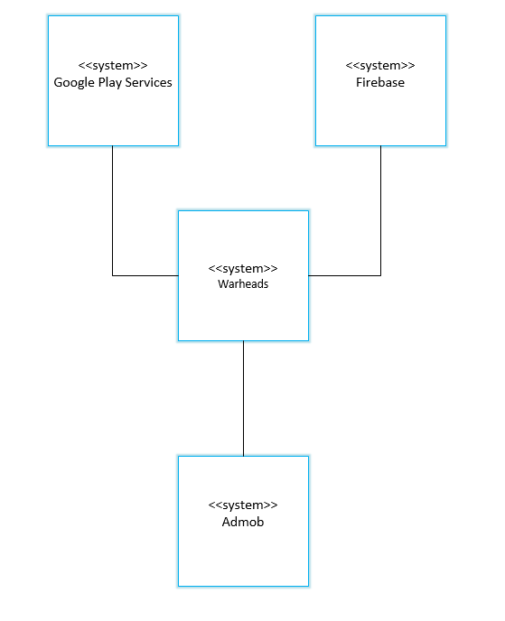
MODELS
Context Models

Slide 5
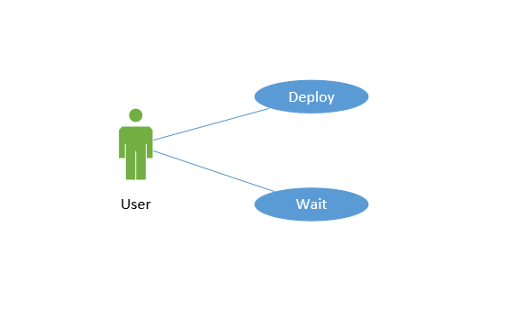
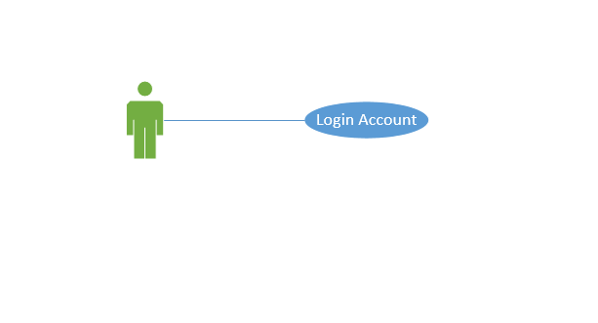
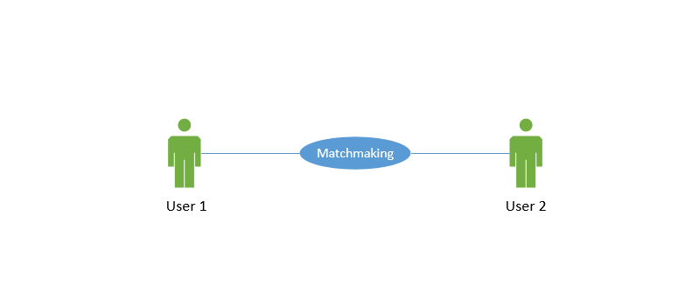
MODELS
Interaction Models

Slide 6
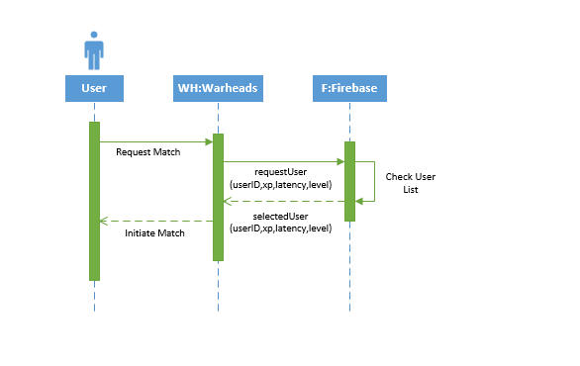
MODELS
Interaction Models

Slide 7
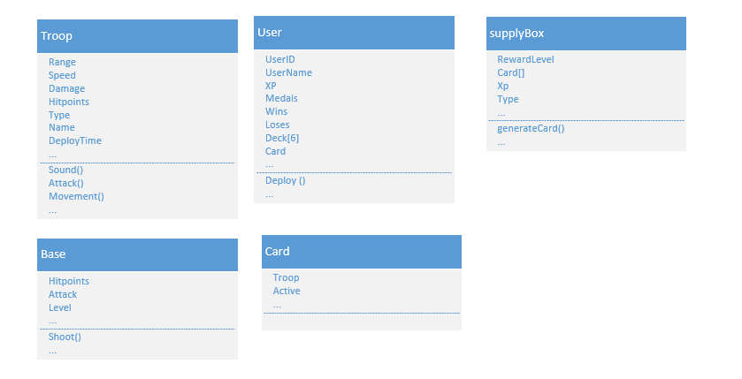
MODELS
Structural Models

Slide 8
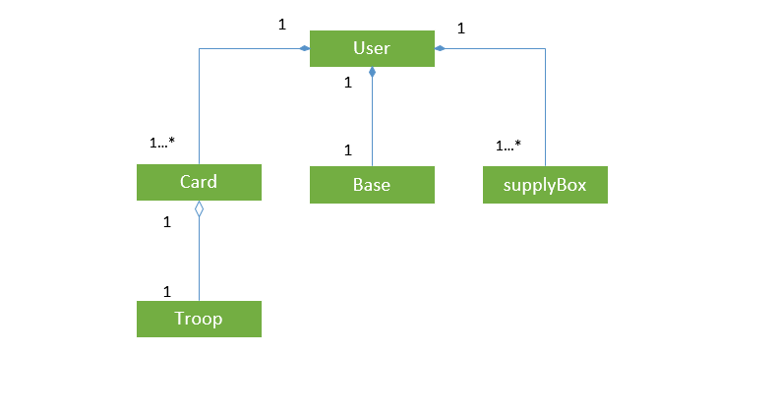
MODELS
Structural Models

Slide 9
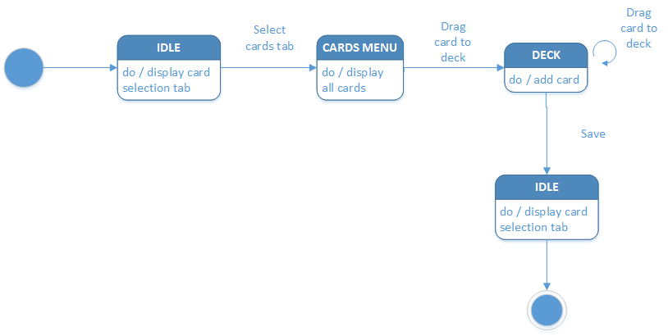
MODELS
Behavioral Models

Slide 10
LENSES
The lens of functional space
The lens of time
The lens of state machine
The lens of secrets
The lens of emergence
The lens of action
The lens of goals
The lens of skill
The lens of chance

Slide 11
LENSES
The lens of state machine
Objects: Canvas, Panels, Buttons, Toggles, Labels, Images, Vertical Scrollbars, Cards, Troops, Buildings, Map, etc.
Each button and toggle will have it’s own action listener associated with it that will perform specific tasks.

Slide 12
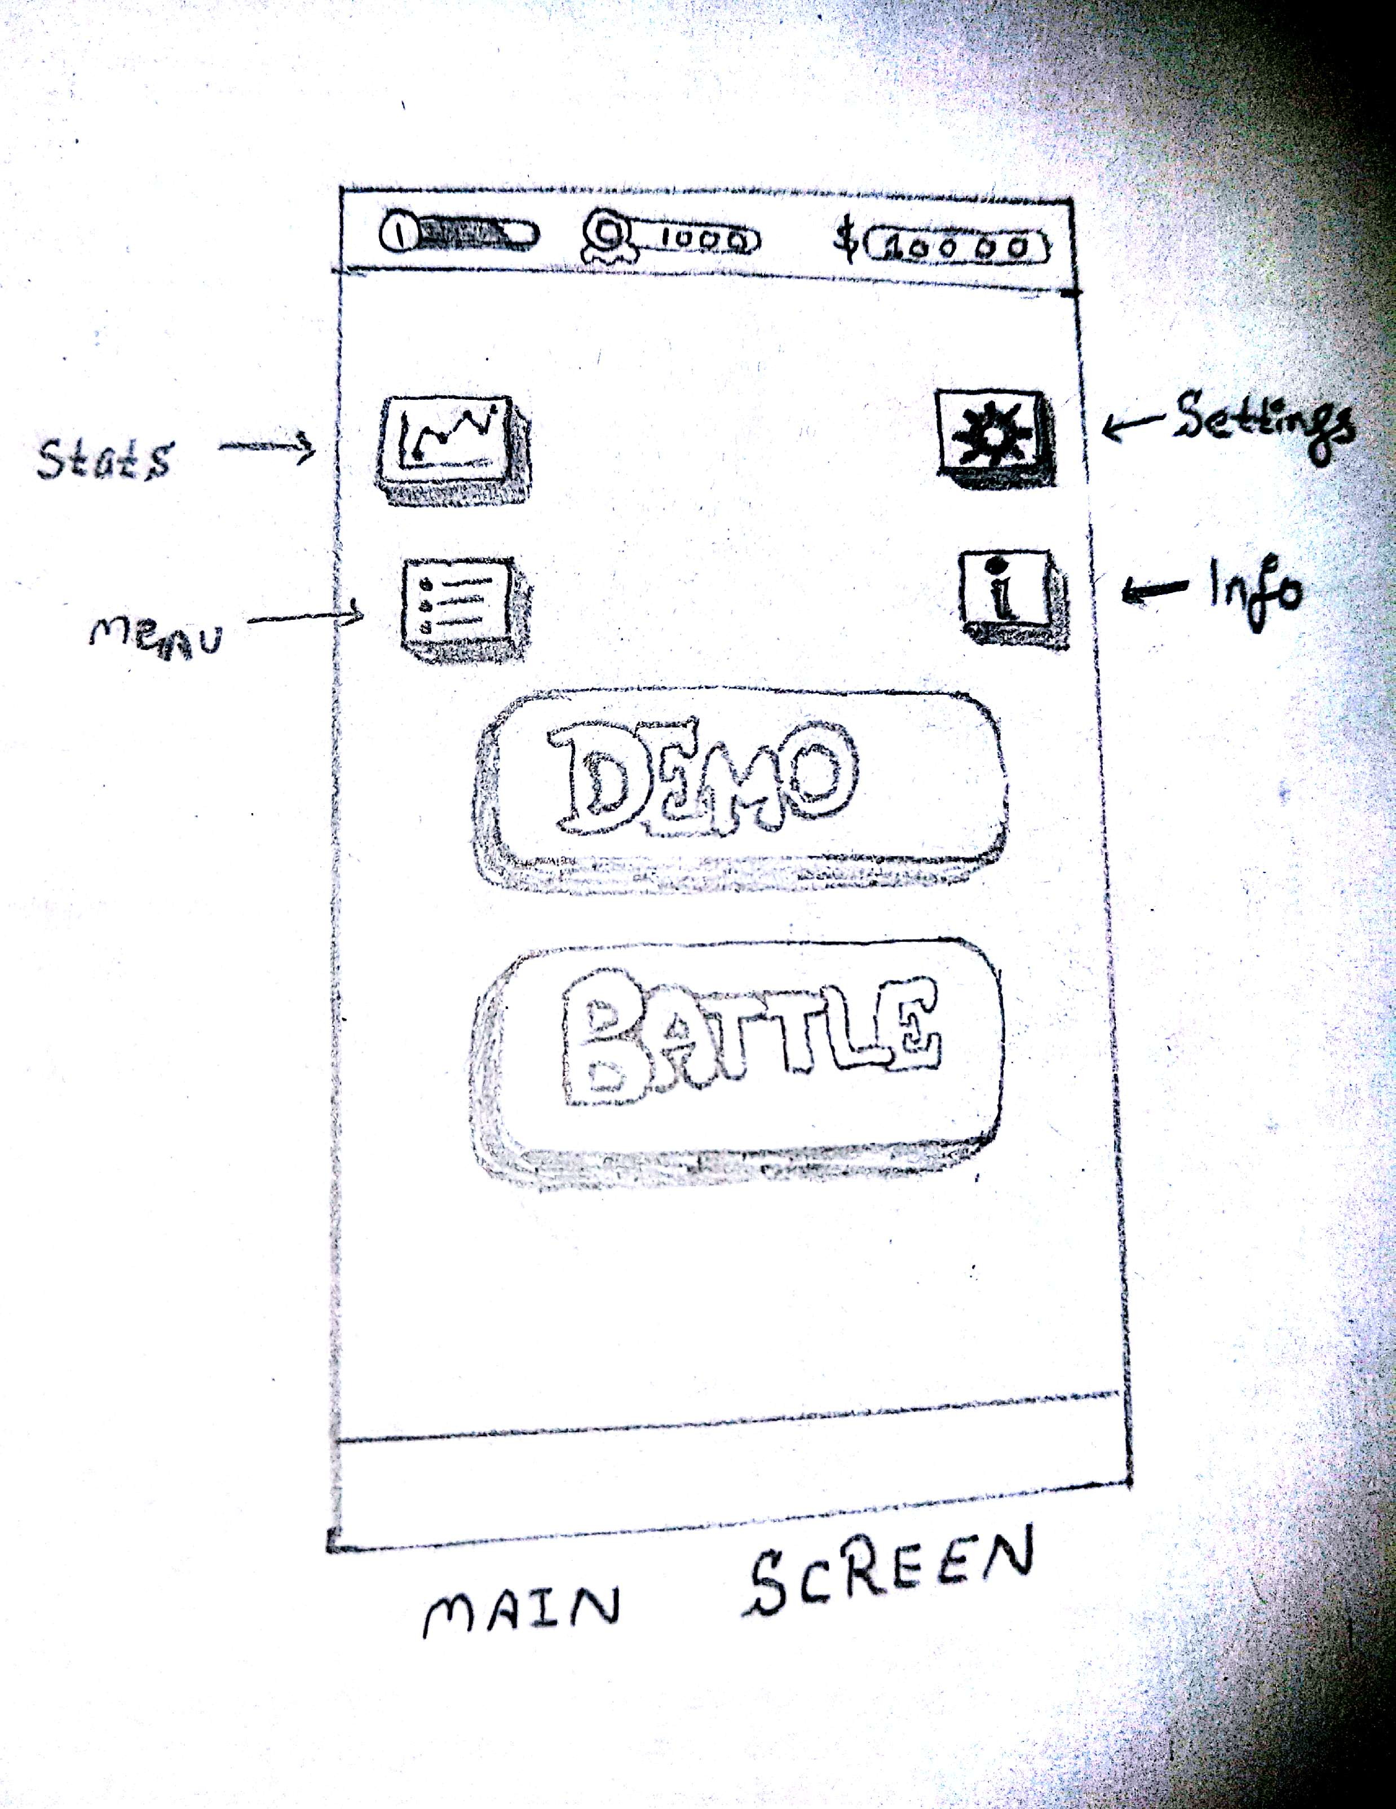
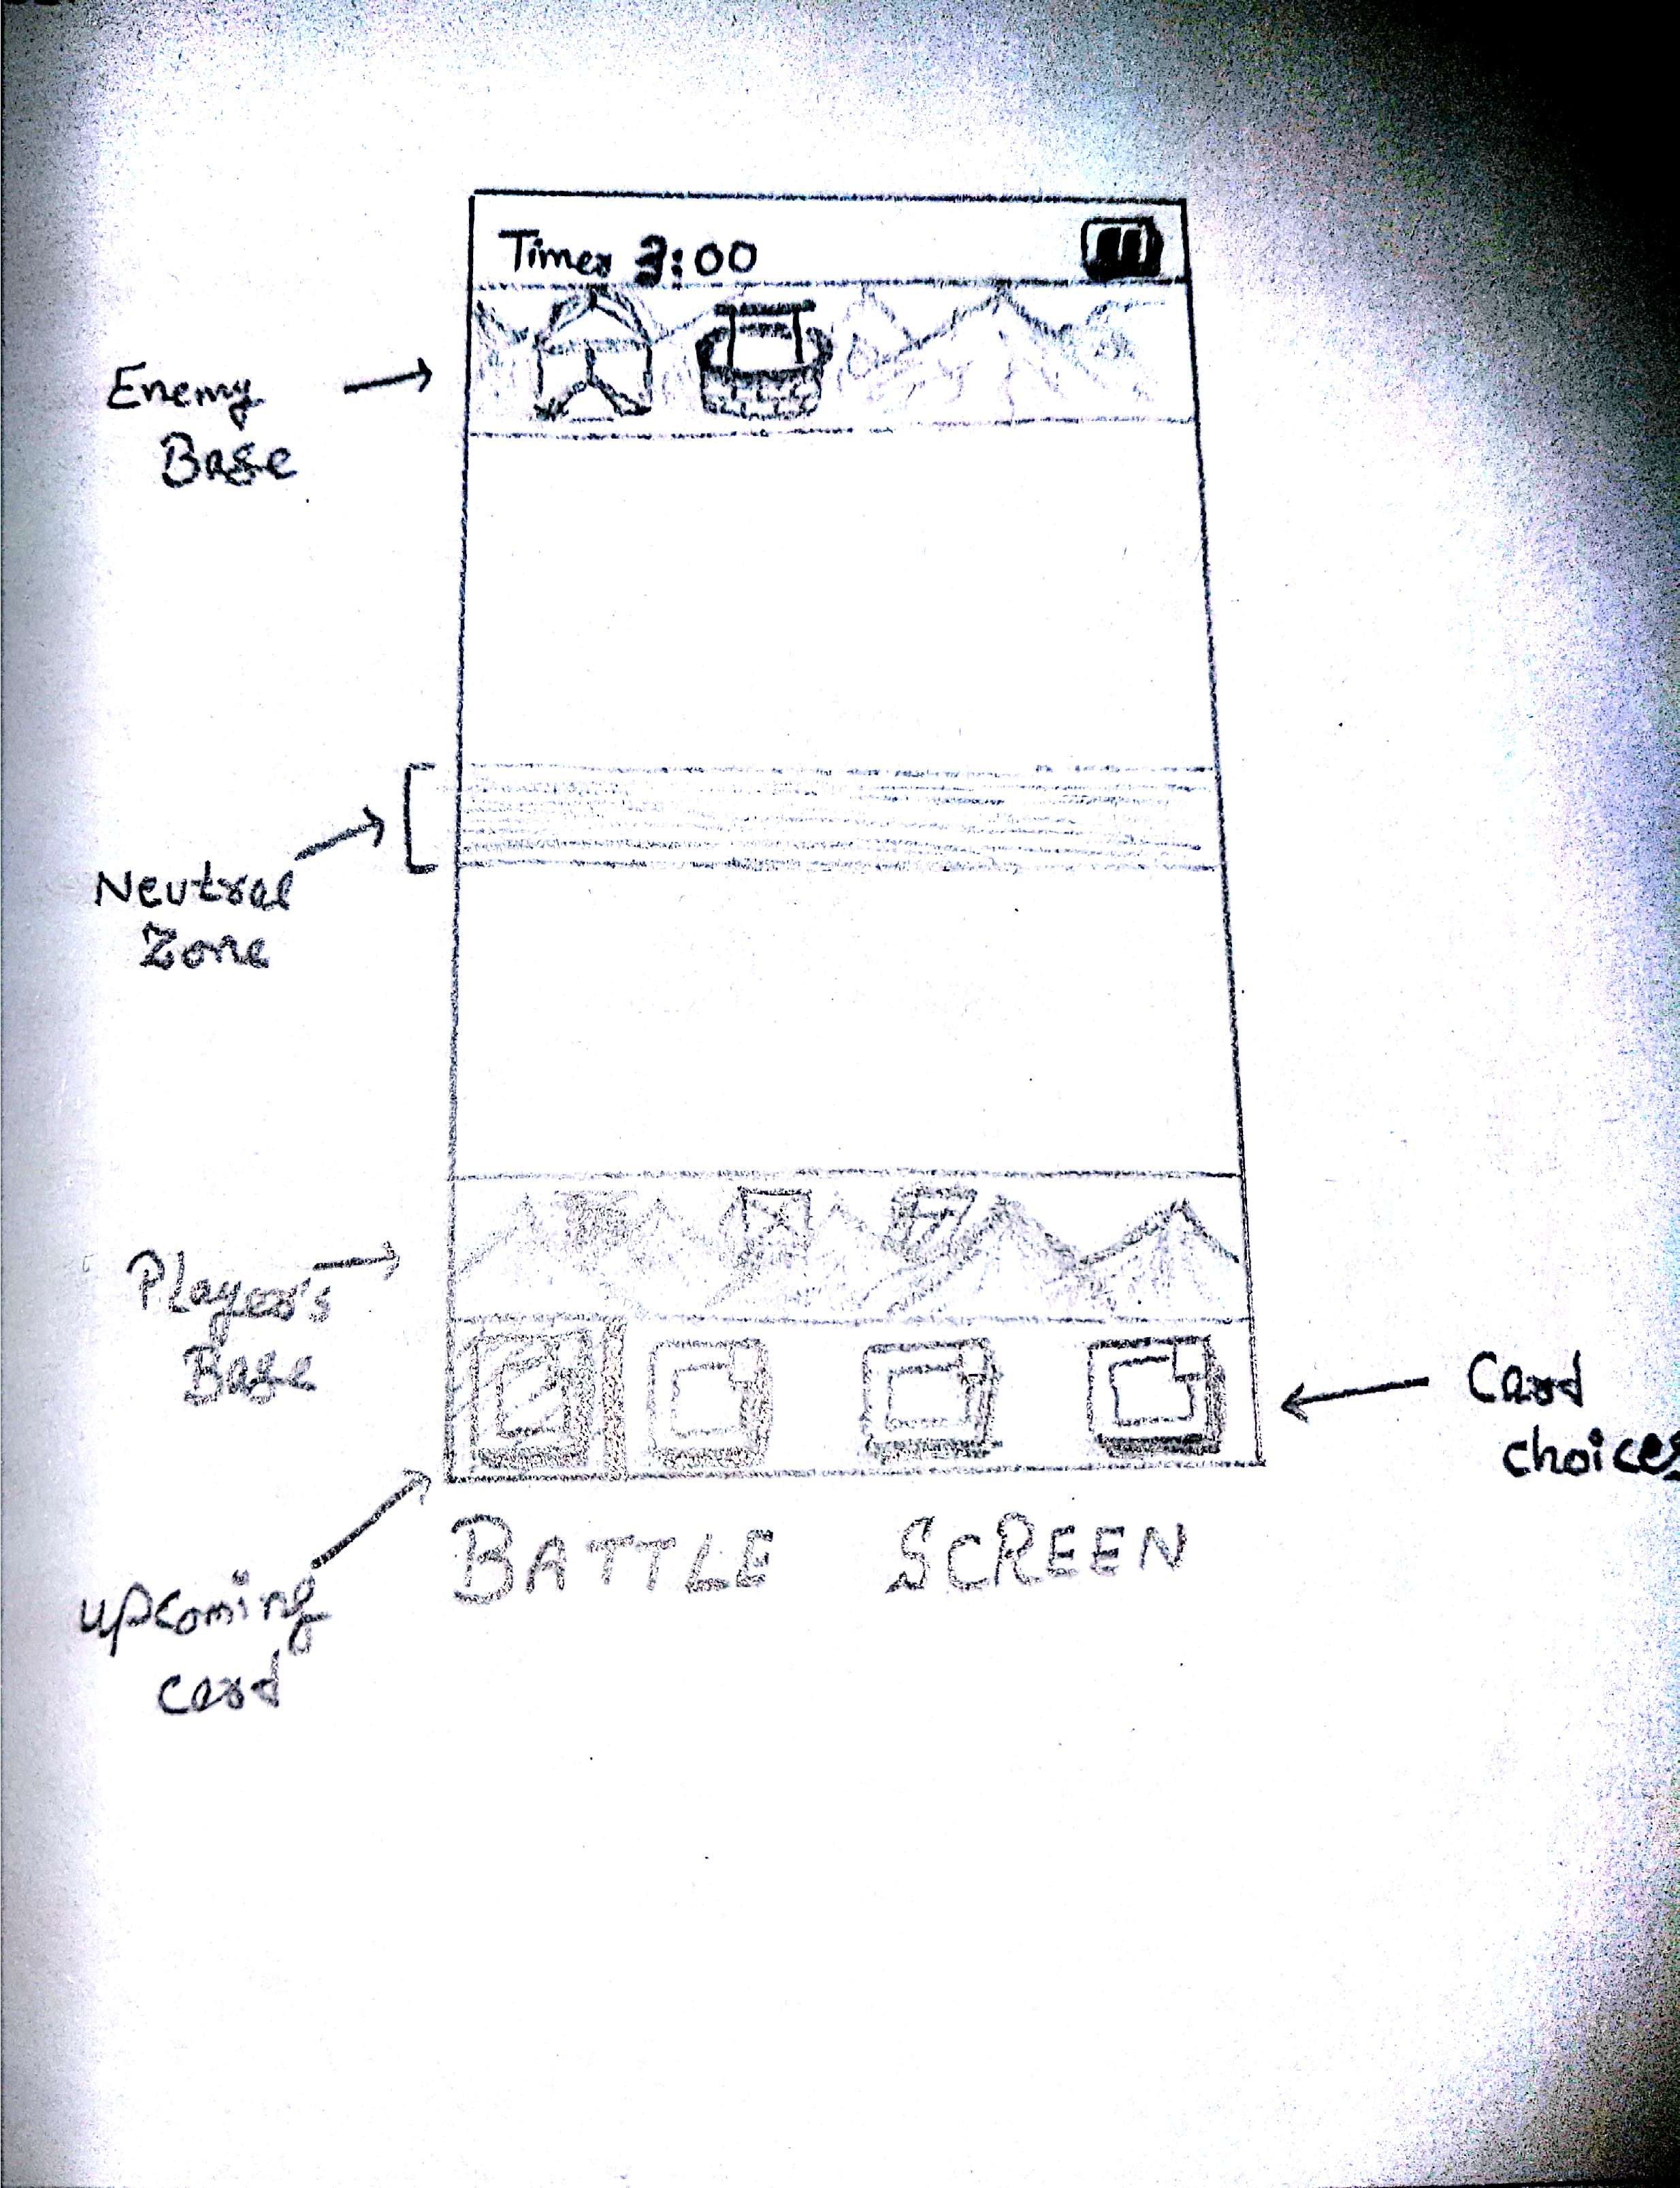
GAME SPACE IMAGES

Slide 13
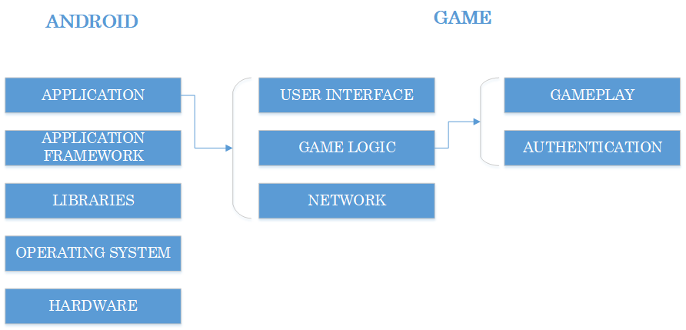
ARCHITECTURE
Layered Architecture

Slide 14
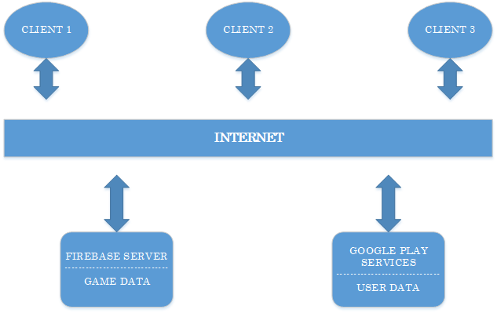
ARCHITECTURE
Client Server Architecture

Slide 15
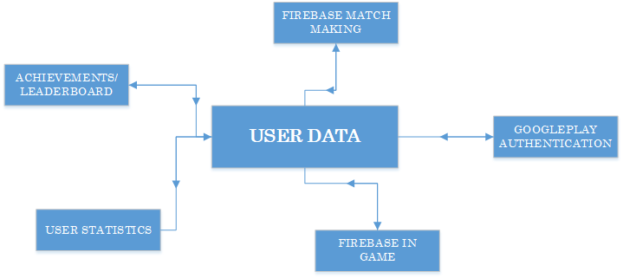
ARCHITECTURE
Repository Architecture

Slide 16
THANK YOU
☺

